Slide 1
Understanding Memory Constraints In High-Performance Computing For Large-Scale Climate Simulations

Slide 2

Introduction
High-performance computing plays a crucial role in large-scale climate simulations.
Memory constraints are a significant consideration in optimizing performance.
Understanding memory utilization is key to enhancing computational efficiency.
1
Notes:
Image source: https://www.trentonsystems.com/en-us/resource-hub/blog/high-performance-computing

Slide 3
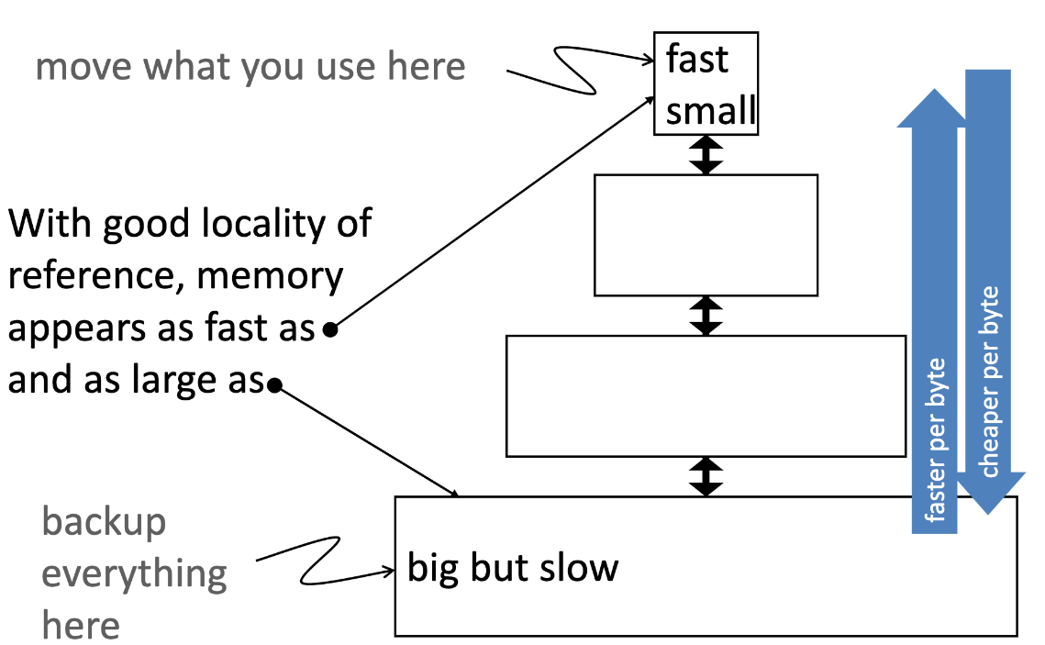
Importance of Memory Optimization
Efficient memory management is essential for handling vast datasets in climate simulations.
Memory constraints impact the scalability and performance of HPC systems.
Proper memory utilization can reduce bottlenecks and enhance overall simulation speed.
2
Notes:
Image source: https://dinolii.github.io/2021/03/15/memory-optimization/

Slide 4
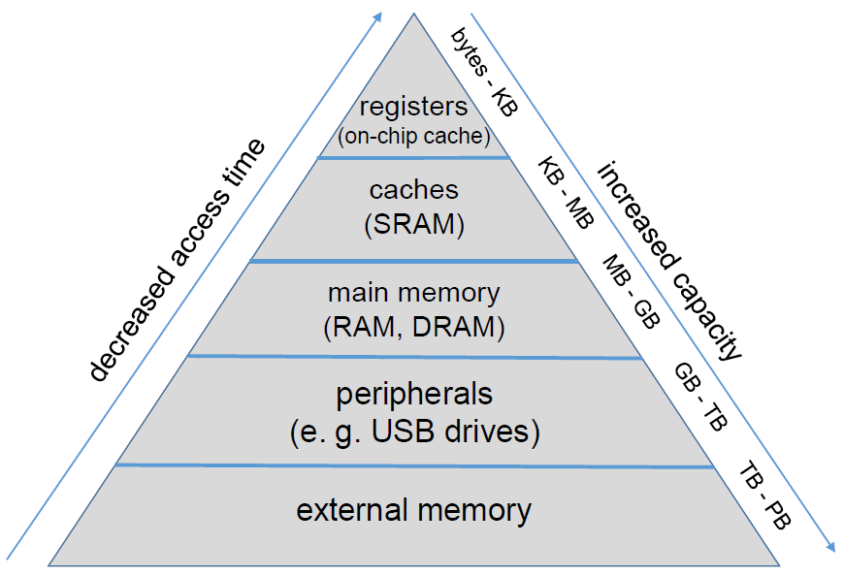
Memory Hierarchy in HPC Systems
HPC systems have a complex memory hierarchy including registers, cache, RAM, and storage.
Data locality optimization is critical for minimizing memory access latency.
Utilizing caches effectively can improve performance by reducing data movement.
3
Notes:
Image source: https://hpc-wiki.info/hpc/HPC-Dictionary

Slide 5

Memory Bandwidth Considerations
Memory bandwidth determines the rate at which data can be transferred between memory and processors.
Balancing memory bandwidth usage is crucial for achieving optimal performance.
Memory-intensive applications like climate simulations require efficient utilization of available bandwidth.
4
Notes:
Image source: https://www.researchgate.net/figure/Memory-bandwidth-growth-rate-of-CPU-and-GPU-and-performance-comparison-between-software_fig2_357056128

Slide 6
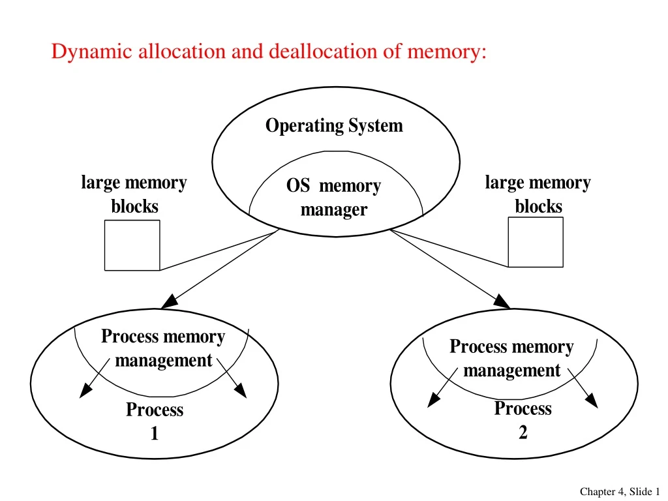
Memory Allocation Strategies
Dynamic memory allocation techniques like NUMA-aware allocation can enhance performance.
Allocating memory in a contiguous manner can reduce fragmentation and improve access speed.
Understanding the memory allocation patterns of climate simulation codes is essential for optimization.
5
Notes:
Image source: https://www.slideserve.com/bonniejones/dynamic-allocation-and-deallocation-of-memory-powerpoint-ppt-presentation

Slide 7
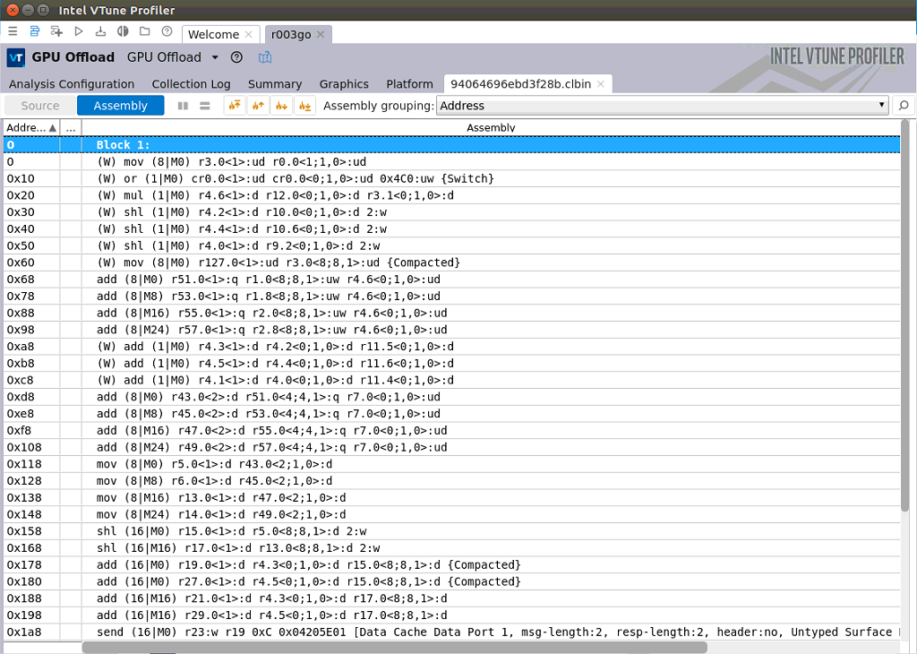
Memory Profiling Tools
Tools like Valgrind and Intel VTune can help in profiling memory usage and identifying inefficiencies.
Memory profiling provides insights into memory access patterns and usage.
Optimization based on profiling results can lead to significant performance improvements.
6
Notes:
Image source: https://www.intel.cn/content/www/cn/zh/developer/articles/training/tutorial--run-vtune-profiler-gui-on-intel-oneapi-iot-toolkit-container.html

Slide 8
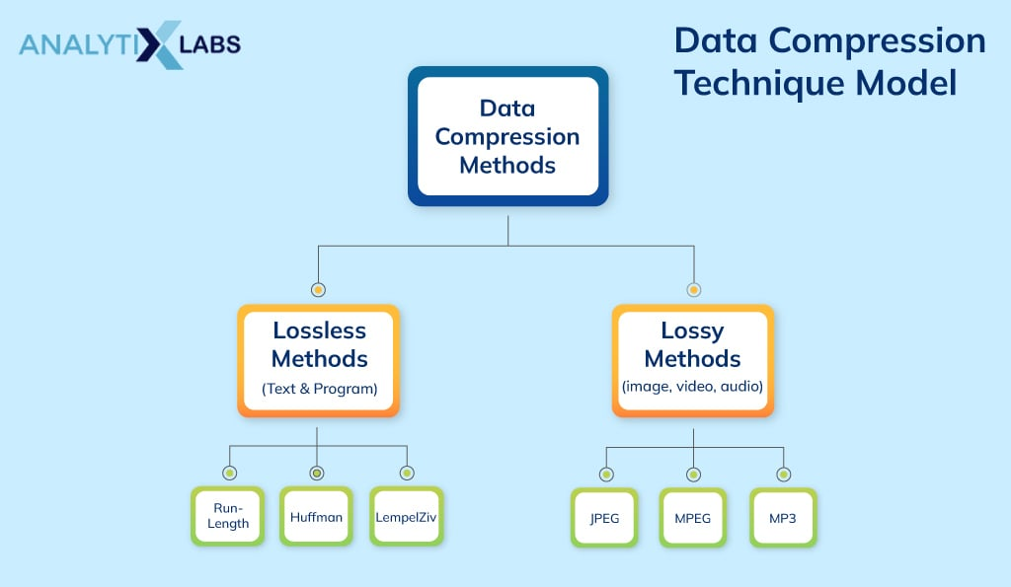
Data Compression Techniques
Data compression methods can reduce memory footprint and alleviate memory constraints.
Lossless compression algorithms like zlib can be applied to climate simulation data.
Balancing compression overhead with memory savings is crucial for efficient utilization.
7
Notes:
Image source: https://www.analytixlabs.co.in/blog/data-compression-technique/

Slide 9

Memory-Efficient Algorithms
Developing memory-efficient algorithms can reduce the overall memory requirements of simulations.
Implementing parallel algorithms that minimize memory consumption can improve scalability.
Utilizing data structures optimized for memory usage can enhance performance.
8
Notes:
Image source: https://www.vrogue.co/post/lstm-architecture-in-hybrid-model-download-scientific-diagram

Slide 10

Memory Management Best Practices
Implementing proper memory management practices such as avoiding memory leaks is essential.
Using memory pools and recycling mechanisms can reduce overhead associated with memory allocation.
Regularly monitoring memory usage and implementing optimizations based on profiling results is key.
9
Notes:
Image source: https://data-flair.training/blogs/memory-management-in-computer/

Slide 11
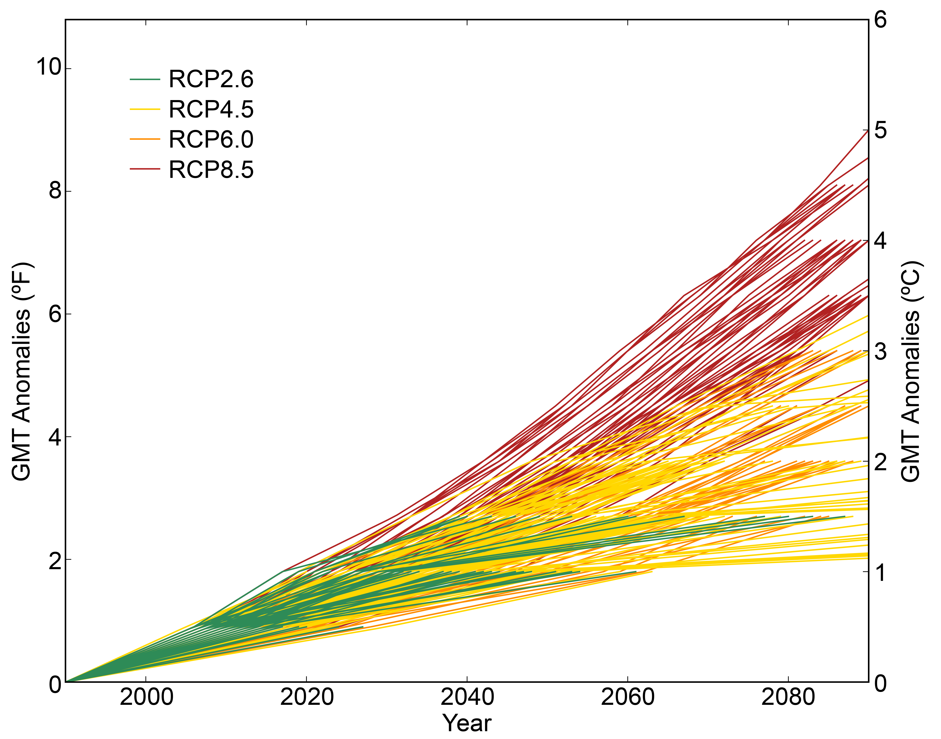
Impact of Memory Constraints on Climate Simulations
Memory constraints can limit the size and complexity of climate models that can be simulated.
Insufficient memory can lead to increased disk I/O operations, impacting performance.
Addressing memory constraints is crucial for running high-fidelity simulations at scale.
10
Notes:
Image source: https://mungfali.com/explore/Climate-Change-Projections

Slide 12

Case Study: Memory Optimization in Climate Modeling
Case studies showcasing memory optimization techniques in climate modeling can provide valuable insights.
Optimizing memory usage in specific components of climate models can lead to performance gains.
Balancing computational requirements with memory constraints is a common challenge in climate simulation research.
11
Notes:
Image source: https://www.studocu.com/row/document/king-abdulaziz-university/system-analysis-and-design-thlyl-otsmym-alnthm/223ism-example-of-dimensional-modeling-case-study-with-solution/13074512

Slide 13

Future Trends in Memory Optimization
Emerging technologies like non-volatile memory (NVM) offer new opportunities for memory optimization.
Machine learning techniques can be utilized to predict memory access patterns and optimize performance.
Continued research in memory optimization will be essential for pushing the boundaries of large-scale climate simulations.
12
Notes:
Image source: https://www.slideserve.com/holmes/emerging-non-volatile-memories-opportunities-and-challenges-powerpoint-ppt-presentation

Slide 14
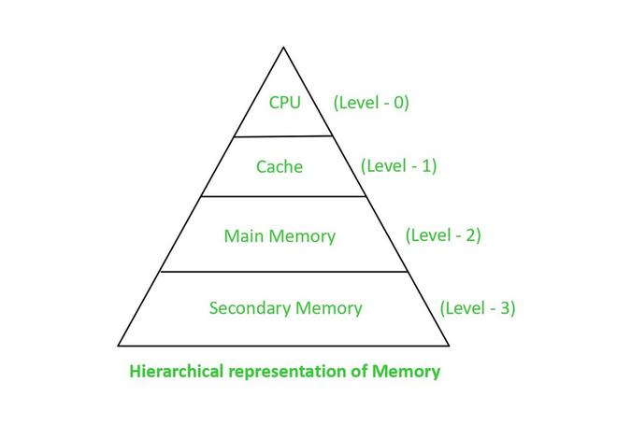
Challenges in Memory Optimization
Balancing memory optimization with other performance metrics like computational speed is a challenge.
Adapting memory optimization techniques to evolving HPC architectures requires continuous effort.
Addressing memory constraints in heterogeneous computing environments adds complexity to optimization strategies.
13
Notes:
Image source: https://www.geeksforgeeks.org/basic-cache-optimization-techniques/

Slide 15

Conclusion
Memory constraints play a critical role in the performance of high-performance computing for climate simulations.
Optimizing memory utilization through efficient algorithms and profiling tools is essential for enhancing performance.
Continued research and innovation in memory optimization are necessary to meet the demands of large-scale climate simulations.
14
Notes:
Image source: https://newrycorp.com/insights/blog/high-performance-computing/

